Slide 1
The VBA of Wall Street
Bryce Davis

Slide 2
Sub wall_street_hw()
Dim Ticker As String
Dim TotalStockVol As Long
TotalStockVol = 0
Dim Summary_Table_Row As Integer
Summary_Table_Row = 2
'Determine last row and last column
LastRow = Cells(Rows.Count, 1).End(xlUp).Row
LastColumn = Cells(1, Columns.Count).End(xlToLeft).Column
'Add in necessary Headers
Cells(1, 11).Value = "Ticker"
Cells(1, 12).Value = "Total Stock Volume"
'Loop through all tickers
For i = 2 To LastRow
'Check if we are still within the same ticker symbol, if not...
If Cells(i + 1, 1).Value <> Cells(i, 1).Value Then
'Set the ticker symbol
Ticker = Cells(i, 1).Value
'Sum to the Total Stock Volume
TotalStockVol = TotalStockVol + Cells(i, 7).Value
'Print the ticker symbol in the Summary Table
Range("K" & Summary_Table_Row).Value = Ticker
'Print the Total Stock Volume to the Summary Table
Range("L" & Summary_Table_Row).Value = TotalStockVol
'Add one to the summary row
Summary_Table_Row = Summary_Table_Row + 1
'Reset the Total Stock Volume
TotalStockVol = 0
End If
Next i
Columns("A:L").AutoFit
End Sub

Slide 3
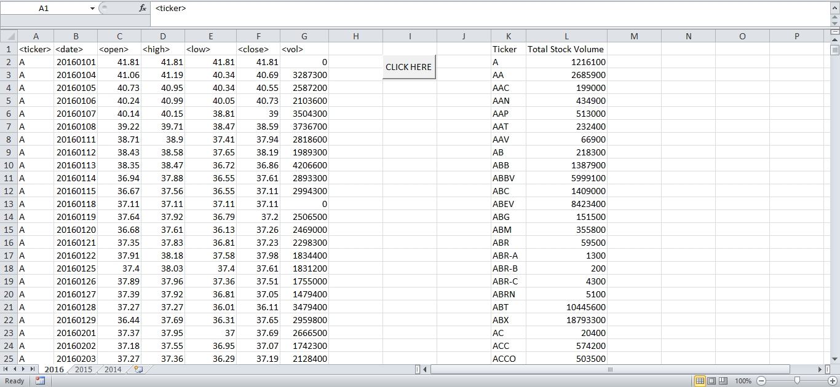

Slide 4
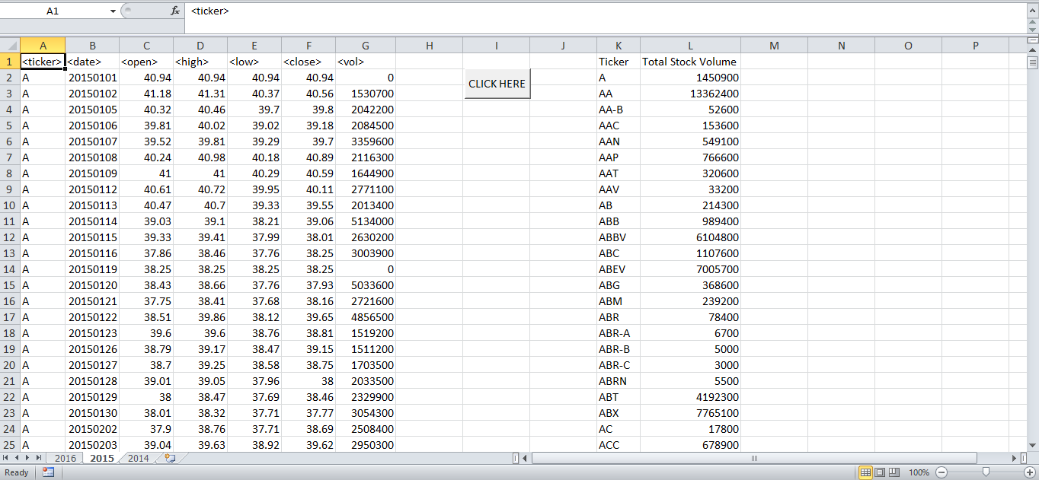

Slide 5
